Slide 1

The HashiCorp Nomad

Slide 2
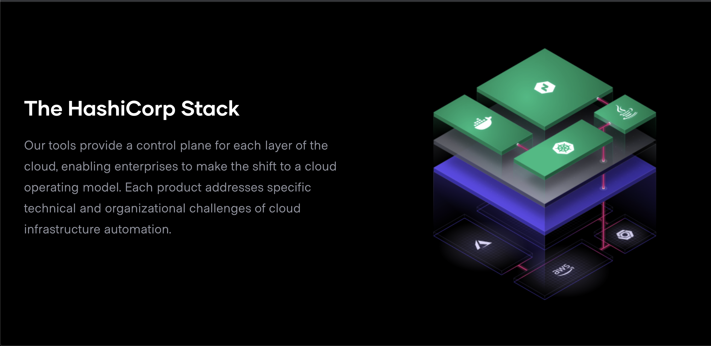

Slide 3
What is HashiCorp Nomad?
A flexible workload orchestrator
Declarative style (IaC)
Notes:
Orchestrator is a software which was automatic process of managing or scheduling the work of individual application/service within cluster(s).
Simply mean automation of all aspects of coordinating and managing application/software.

Slide 4
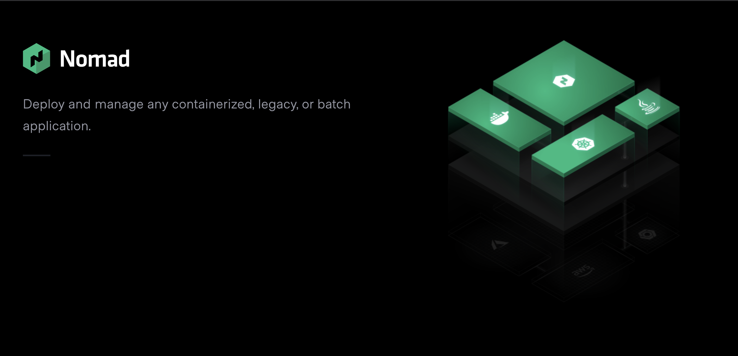

Slide 5
Nomad key features
Deploy Containers and Legacy Applications like binary, Java
Simple & Reliable
Proven scalability
And many more
Notes:
Simple: Ease to deploy and maintain
Reliable: Auto handle application, node and driver failure.
Nomad leader election enabled by Raft Consensus protocol
Roblox has deploy over 11k nodes over the worlds.

Slide 6
HashiCorp Nomad Architect

Slide 7
Why Nomad but not X?
K8S:
Nomad is much simple and more general purpose.
K8S need lot of things to fully functional, Nomad only need single binary to work.
K8S only support containerized application. Nomad support most type of application, including container.

Slide 8
Why Nomad but not X?
Ansible:
Ansible can deploy application too, but its more like configuration management. The same goes for Chef/Puppet
Terraform:
Terraform can also deploy application, but its more like provisioning tools.
These tools are not ORCHESTRATOR!!!

Slide 9
Why Nomad? Again!
Currently we had already relied on Consul, which was one of many software in The HashiStack. Nomad is seamlessly connect with Consul to support Service Discovery.
Less magic! – There will be less Black Magic, Nomad try to do one and only one thing: orchestrate workload.

Slide 10

DEMO
Notes:
https://github.com/liemle3893/nomad-introduction

Slide 11
Question and Answer

Slide 12
References
https://www.hashicorp.com/
https://stackshare.io
https://nomadproject.io/

